Slide 1
Title: Places most Covid-19 infected cases and deaths in New York
Applied Data Science Capstone - Final Project
Student: Rafael mejia S.

Slide 2
INTRODUCTION/BUSINESS PROBLEM
The pandemic Covid-19 is a tragedy that affected a millions of people around the world.
United States was not exception, especially New York City. It’s a place where the illness growth exponentially during the last three months.
For this reason we need to know the places where the cases and deaths for Covid-19 were most affected. Which are the features of the neighborhood and how can improve or prevent for the future the cases will not raise quickly.

Slide 3
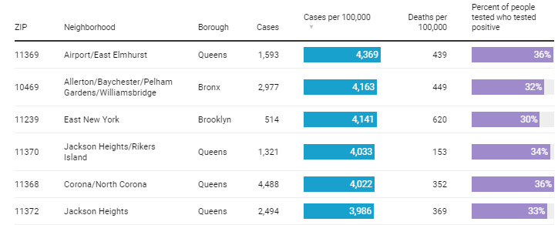
DATA TO USE
To solve the problem, we will use the dataset of Covid-19 belong to New York City governance. This data contains the Zip, Neighborhood, Borough, Cases, Cases per 100.000, Deaths per 100.000 and the Percent of people tested who tested positive.
This data we will combine with the information of foursquare to get the features of each neighborhood and make the analysis with the algorithms learned in this course.

